Slide 1
Restaurant_v_final
File created on: 2019-05-05 5:31:12 PM

Slide 2
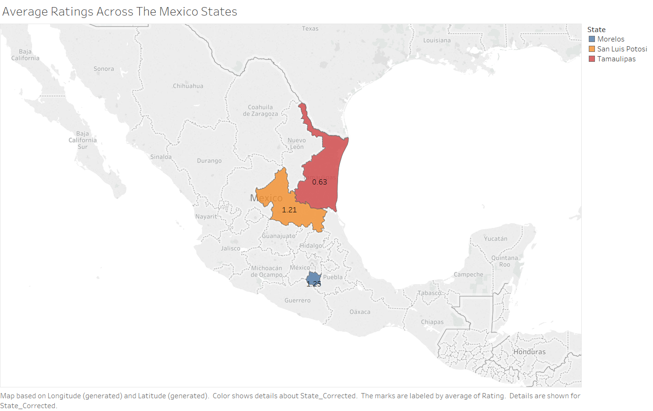

Slide 3
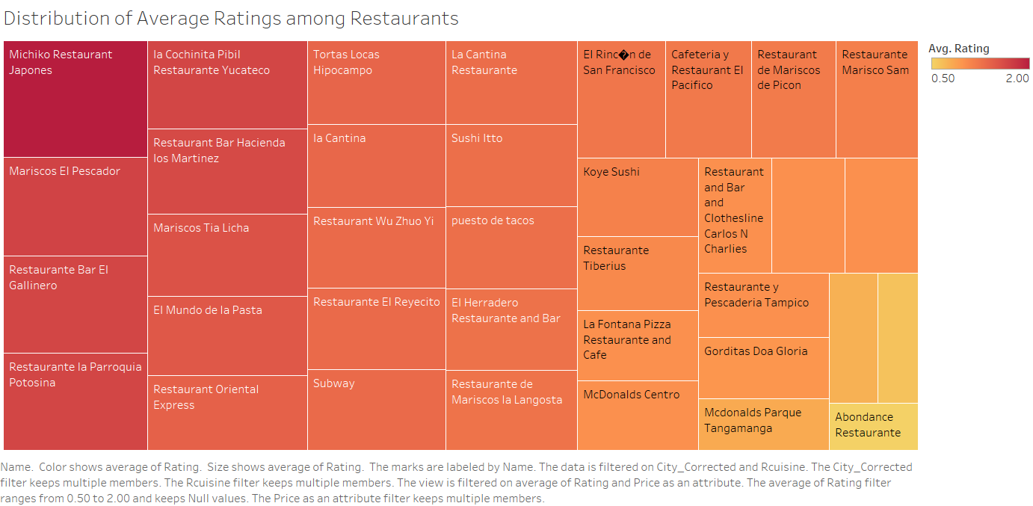

Slide 4


Slide 5


Slide 6
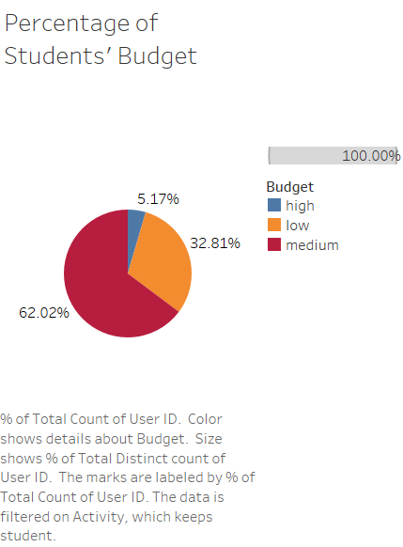

Slide 7
